Slide 1
Impacts of Global Events on the International Insolvency Practice
Antonia Menezes
Senior Financial Sector Specialist
World Bank Group

Slide 2
Q1: What have been the effects of the pandemic on insolvency filings?

Slide 3
Impact on insolvencies (1)
A wave of insolvencies, which many predicted in the immediate onset of COVID-19, does not appear to have materialized, yet.
Nonetheless the following factors may point to a rise in the near to medium term:
End of fiscal stimulus and temporary “emergency” changes to insolvency laws.
Inflation and consequent interest rate rises.
A prevalence of “zombie” companies.
Altradius (a credit insurer) predicts a substantial rise in insolvencies in 2022 and 2023 (graph opposite).
Notes:
Come to the chart last – relates to final dot point.
On dot point 1: There is some early evidence of a recent rise in insolvencies in some jurisdictions, but most data suggests insolvency filings in most jurisdictions remain at pre-pandemic levels.
On 2.1: We discuss this on slide 6.
On 2.2 and 2.3: These issues are interrelated and relate to the issue of corporate debt overhang, which is discussed on slide 7. Since companies are heavily indebted, marginal increases in interest rates dramatically will impact their ability to repay. This is particularly the case for “zombie companies” that were already unprofitable and were having their loans “evergreened” – a practice which will be harder to maintain in a high interest rate environment.
On Corporate Debt Overhang: Nonfinancial corporate debt in EMDEs has been accumulating since the global financial crisis—from 56 percent of GDP in 2008 to 103.5 percent of GDP in Q4 of 2020. World Bank, Corporate Debt Overhang paper.
On 3rd dot point and the chart: Note that in most cases these are percentage increases from historic lows. However, it does show that for many countries an increase of at least 50% (and in some countries, almost double) in insolvencies.

Slide 4
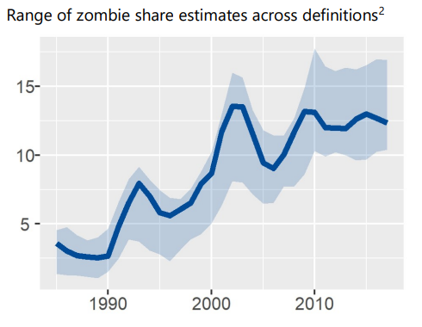
Impact on insolvencies (2)
Source: Bank for International Settlements, ‘Corporate zombies: Anatomy and life cycle’ (2018) at p 9.
Notes:
Sources: [1] Bank for International Settlements, ‘Corporate zombies: Anatomy and life cycle’ (2018) ; [2] Sergio Muro, ‘Insolvency Systems and zombie firm proliferation in high and middle income economies’ (forthcoming). [3] World Bank, World Development Report (2022), chapter 3.

Slide 5
Q2: What are current macro-economic concerns that are expected to affect enterprise solvency?

Slide 6
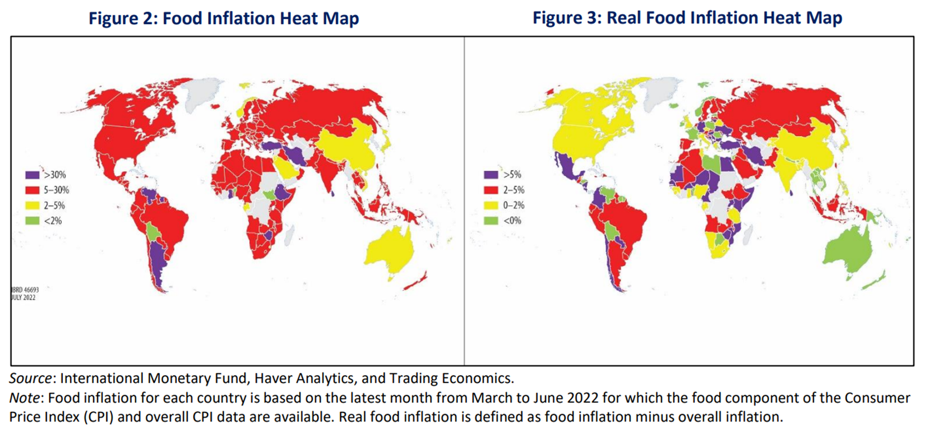
Inflation and Economic Impact (1)
Source: World Bank, ‘Food Security Update’ (29 July 2022).
Notes:
Information from between March and June 2022 shows high inflation in almost all low- and middle-income countries; 93.8% of low-income countries, 89.1% of lower-middle-income countries, and 89% of upper-middle-income countries have seen inflation levels above 5%, with many experiencing double-digit inflation. The share of high-income countries with high inflation has also increased sharply, with about 78.6% experiencing high food price inflation.

Slide 7
Inflation and Economic Impact (2)
Source: World Bank, ‘Global Economic Prospects’ (June 2022).
Notes:
Sources: [1] World Bank, ‘Global Economic Prospects’ (June 2022); [2] World Bank, ‘Are we ready for the coming spate of debt crises?’ (March 2022); [3] Government of Sri Lanka, ‘Interim Policy Regarding the Service of Sri Lanka’s External Public Debt (April 2022). [4] World Bank, World Development Report (2022), chapter 5.

Slide 8
Climate Change – specific issues in insolvency
Climate-related insolvency
Pacific Gas & Electric Corporation case (2019) – United States.
Are environmental obligations of companies a “debt”, or something else? How should they rank in priority for repayment?
Orphan Well Association v. Grant Thornton Ltd (2019) – Canada.
“The end-of-life obligations the Regulator seeks to enforce against Redwater are public duties. Neither the Regulator nor the Government of Alberta stands to benefit financially from the enforcement of these obligations. These public duties are owed, not to a creditor, but, rather, to fellow citizens, and are therefore outside the scope of “provable claims”

Slide 9
Q3: What is the World Bank focusing on in order to strengthen EMDE insolvency regimes and address future shocks?

Slide 10
Corporate Debt Overhang
World Bank, ‘White Paper: Addressing the Corporate Debt Overhang’ (March, 2022)
Nonfinancial corporate debt in EMDEs has been accumulating since the global financial crisis—from 56 percent of GDP in 2008 to 103.5 percent of GDP in Q4 of 2020.
Jurisdictions with high, unresolved NPLs experience deeper, longer recessions, and slower recovery.
New dataset on development and key features of corporate debt restructuring mechanisms in 114 countries:
Informal restructuring tools are lacking in 2/3 of countries.
Special restructuring procedures (hybrid or formal) geared towards MSMEs in only 10% of countries.
Higher recovery rate for creditors in countries with “separate entry” procedures.

Slide 11
Thank you!
Email: amenezes@worldbank.org

